Slide 1
Bearcat Job search
Northwest Missouri State University – ACS – GDP – II
Notes:
Are your classroom colors different than what you see in this template? That’s OK! Click on Design -> Variants (the down arrow) -> Pick the color scheme that works for you!
Feel free to change any “You will…” and “I will…” statements to ensure they align with your classroom procedures and rules!

Slide 2







Team Members
ANIL
PRASANNA
MAHENDAR
YUGANDHAR
SANTHOSH
CHANDU

Slide 3
Agenda
Project description
Project hardware requirements
Project software requirements
Database design
How Bearcat Job Search application works?

Slide 4
Project Description
The main perspective of the Bearcat Job Search application is to help recruiters and students in finding their employee and employers respectively
Any one can register and use this Bearcat Job Search Portal for finding their jobs. No restrictions on students other than Bearcats.

Slide 5
Project Hardware Requirements
These are the minimal requirements
Processor: Minimum 1 GHz; Recommended 2GHz or more
Ethernet connection (LAN) OR a wireless adapter (Wi-Fi)
Hard Drive: Minimum 32 GB; Recommended 64 GB or more
Memory (RAM): Minimum 1 GB; Recommended 4 GB or above

Slide 6
Project Software Requirements
These are the minimal requirements
Backend: Node JS
Framework: Adonis JS
Frontend: Vue JS
Database: MySQL
Tools: Visual Studio Code, MySQL Workbench, GIT-CLI,

Slide 7
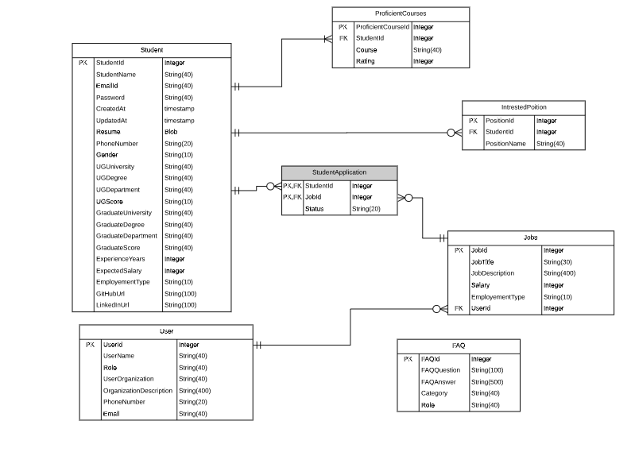
Database Design
Fig: ER diagram

Slide 8
How Bearcat Job Search application works?
Registration Page
Login Page

Slide 9
Bearcat Job Search(Continued..)
Change Password
Forgot Password
Reset Password

Slide 10
Bearcat Job Search(Continued..)
Admin/Add admin/Add Job
Student View – Job Info
CRUD Jobs - Admin

Slide 11
Bearcat Job Search(Continued..)
Student View - Jobs Home page
Student View – Search Functionality
Admin View – Search Functionality

Slide 12
Bearcat Job Search(Continued..)
Student View – Apply Job, Upload resume
Student View – Careers Page
Admin View – Students Job applied (Approve/Deny)

Slide 13
Bearcat Job Search(Continued..)
Student View – Student Profile
Student View – LinkedIn

Slide 14
Bearcat Job Search(Continued..)
Admin View – Download Resume
Admin View – GitHub Integration
Student View – FAQ, About us

Slide 15
Bearcat Job Search(Continued..)
Admin View – About us, Post FAQ
Chat Functionality

Slide 16
Any Questions..?
ANIL
PRASANNA
MAHENDAR
YUGANDHAR
SANTHOSH
CHANDU

Slide 17
Thank you…!!!

